Slide 1
Go-Getters App
The best decision for tutors

Slide 2

What was done?
Logo idea
Sketch of the main page

Slide 3
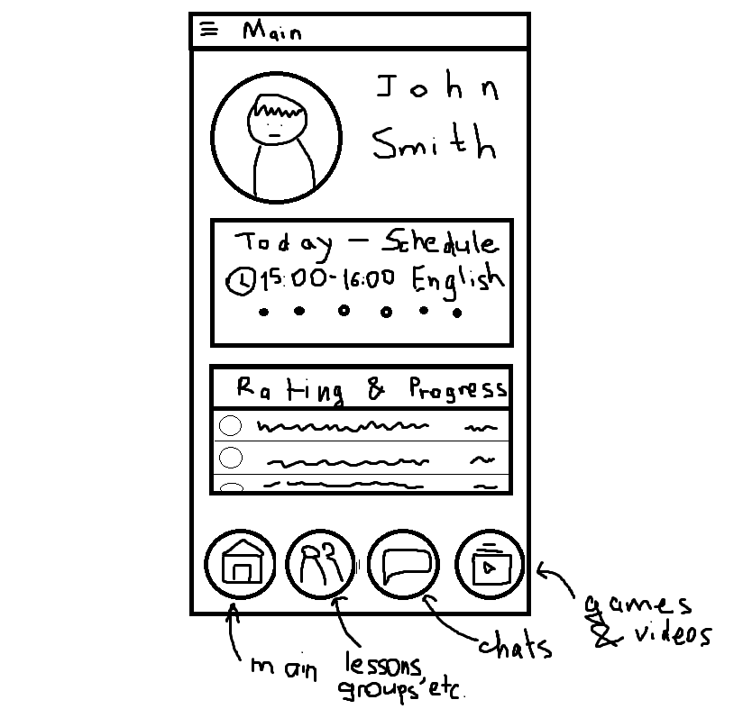
What was done?
Logo idea
Sketch of the main page

Slide 4
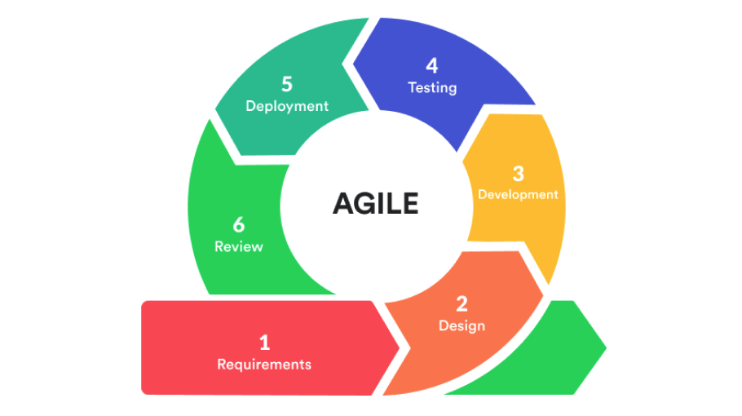
How did we use Agile in our project?

Slide 5
What is SCRUM?
Agile is an iterative and incremental approach to project management that emphasizes flexibility, collaboration, and customer satisfaction. Scrum is one of the most popular Agile frameworks and is used to manage software development projects. It emphasizes teamwork, communication, and continuous improvement. The Scrum framework consists of several key components, including sprints, daily standups, product backlog, sprint backlog, and sprint review. By following the Scrum framework, teams can work together more efficiently and effectively to deliver high-quality software products that meet customer needs.

Slide 6
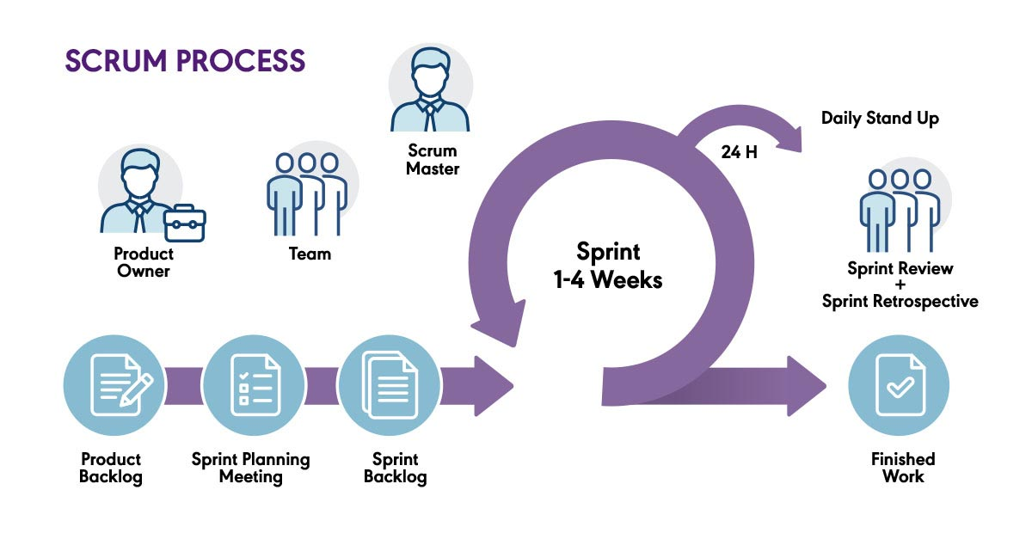
What is SCRUM?

Slide 7
1. Sprint 1 (duration 2 weeks):
- Planning: defining the main features of the application, tasks for the sprint and allocating time for each of them.
- Development: creating a prototype of the application, designing and setting up the basic architecture.
- Standups: daily meetings to discuss progress and issues.
- Review: demonstrating the prototype of the application, discussing the results of work and plans for the next sprint.
- Retrospective: discussing what can be improved in the process.

Slide 8
2. Sprint 2 (duration 3 weeks):
- Planning: defining additional features of the application, tasks for the sprint and allocating time for each of them.
- Development: improving design and architecture, creating main functions of the application.
- Standups: daily meetings to discuss progress and issues.
- Review: demonstrating a working application with new features, discussing the results of work and plans for the next sprint.
- Retrospective: discussing what can be improved in the process.

Slide 9
3. Sprint 3 (duration 4 weeks):
- Planning: defining additional features of the application, tasks for the sprint and allocating time for each of them.
- Development: improving functions of the application, testing and fixing errors.
- Standups: daily meetings to discuss progress and issues.
- Review: demonstrating the final version of the application, discussing the results of work and plans for the next sprint.
- Retrospective: discussing what can be improved in the process.

